Slide 1

Towards a Complete Covering of SBML Functionalities
Tommaso Mazza
t.mazza@unicz.it
‘Magna Græcia’ University of Catanzaro
TexPoint fonts used in EMF.
Read the TexPoint manual before you delete this box.: AAAAAAA

Slide 2

Citizen of the World
kosmopolitês, has been used to describe a wide variety of important views in moral and socio-political philosophy. The nebulous core shared by all cosmopolitan views is the idea that all human beings, regardless of their political affiliation, do (or at least can) belong to a single community, and that this community should be cultivated. Different versions of cosmopolitanism envision this community in different ways, some focusing on political institutions, others on moral norms or relationships, and still others focusing on shared markets or forms of cultural expression.
The Stanford Encyclopedia of Philosophy
Outline
History of SBML
SBML Functionalities
Dissecting SBML
Test
Tommaso Mazza

Slide 3
SBML … Its history (1/5)
March 2001
  Systems Biology Markup Language (SBML @ www.sbml.org)
    Simple
    Well supported
    Textual Substrate (xml-based)
November 2002
  Different packages can have different niche strengths and their strengths are often complementary. (M. Hucka)
  No single tool is able perform likewise in the near future because the range of capabilities needed is large and new techniques and new tools evolve all the time making simulations and results often not shareable or reusable. (M. Hucka)
Tommaso Mazza

Slide 4
SBML … Its history (2/5)
May 2003
  CellML (www.cellml.org) (bring them together)
    MathML (http://www.w3.org/Math/)
      http://sbml.org/xml-schemas/mathml/sbml-mathml.xsd
    Metadata Specification
  BioPAX (http://www.biopax.org/)
  libSBML (http://sbml.org/software/libsbml/)
Still in 2003 …
The Systems Biology Workbench (project started in 2000) (http://sbw.sourceforge.net/)
    Sharing of Simulations/Analysis Software and Models
    Enable collaborations among software developers.
Tommaso Mazza

Slide 5
SBML … Its history (3/5)
2004
  Limitation of the current release of SBML;
  MathSBML (http://sbml.org/software/mathsbml/)
  a Mathematica package designed to manipulate SBML models.
2005
  Minimum Information Requested in the annotation of biochemical model (MIRIAM).
  Definition of a minimum quality standard for the encoding of biochemical models by means of rules explaining how to encode and annotate models.
  A tool for using the SBML format to represent p systems which model biological reaction networks (Romero-Campero et. Al)
Tommaso Mazza

Slide 6
SBML … Its history (4/5)
BioModels database (http://www.ebi.ac.uk/biomodels/)
an annotated resource of quantitative models of biomedical interests. (models accurately curated and annotated with GO, …) Last Release on 5th June
CellML2SBML (http://sbml.org/software/cellml2sbml/)
XSLT stylesheet
KEGG2SBML tool (http://sbml.org/software/kegg2sbml/)
SBMLToolbox (http://sbml.org/software/sbmltoolbox/)
SBML ↔ Matlab
SBML Ode Solver Library (http://www.tbi.univie.ac.at/~raim/odeSolver/)
(programming library) symbolic and numerical analysis of chemical reaction networks
SBML-PET (http://sysbio.molgen.mpg.de/SBML-PET/)
Parameter Estimation.
SBML2PiCalc: SBML ↔ π-calculus
P Systems modelling Framework (Gheorghe) (http://www.dcs.shef.ac.uk/~marian/PSimulatorWeb/PSystemMF.htm)
2006
Tommaso Mazza

Slide 7
SBML … Its history (5/5)
2007
  SBMLR (http://epbi-radivot.cwru.edu/)
  Parser of SBML for R (R + libsbml)
  SemanticSBML (http://sysbio.molgen.mpg.de/sbmlmerge/)
  To make easy merging SBML models (by using MIRIAM)
  SBMLeditor (http://www.ebi.ac.uk/compneur-srv/SBMLeditor.html)
  Editor di SBML file (libsml)
  […]
  Over 110 software and tools understand SBML!
Tommaso Mazza

Slide 8
Repositories
PANTHER classification system (http://www.pantherdb.org/) (L1 V2)
  Classifies genes by their function (by means of public scientific experimental evidence)
Kyoto Encyclopedia of Genes and Genomes (KEGG) (http://www.genome.jp/kegg/) (L2 V1 and L1 V2)
  Genes functions, linking genomic information
JWS Online (http://jjj.biochem.sun.ac.za/) (L2 V1)
  Tool for simulation of kinetic models from a curated database;
Reactome (http://www.reactome.org/) (L2 V1)
  Core pathways and reactions in human biology (and other 22 not-human species) [cross-referenced]
  BioModels database: (http://www.ebi.ac.uk/biomodels/) (L2 V1) Last Release on 5th June
  Gepasi (http://www.gepasi.org/). A software package for modeling biochemical systems. (L1 V1)
Tommaso Mazza

Slide 9
SBML: Levels and Versions
Level = Major releases (substantial changes)
Version = Minor revisions of whatever level of a SBML file will bring a new version.
LEVEL 2
V1
V2
V3
V1
V2
LEVEL 1
Tommaso Mazza

Slide 10
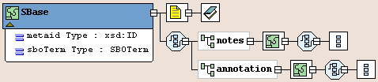
SBML: Structure and Hierarchy (1/3)
Each type in a model derives directly or indirectly from a single abstract type called Sbase.
It allows modeller or a software package to attach arbitrary information to each major structure or list in an SBML model.
All other types have at least other three parameters:
  id, (mandatory field)
  name (optional field) [to provide a human readable label for the component];
  sboTerm (optional field) [to identify a term from an ontology]
Tommaso Mazza

Slide 11
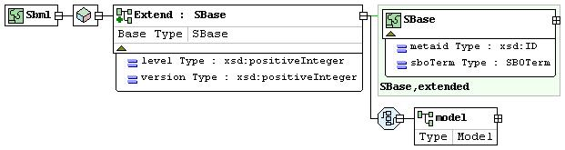
SBML: Structure and Hierarchy (2/3)
Mandatory
SBML envelope
  The root of a SBML file.
Model
  The highest level construct in a SBML document.
Tommaso Mazza

Slide 12
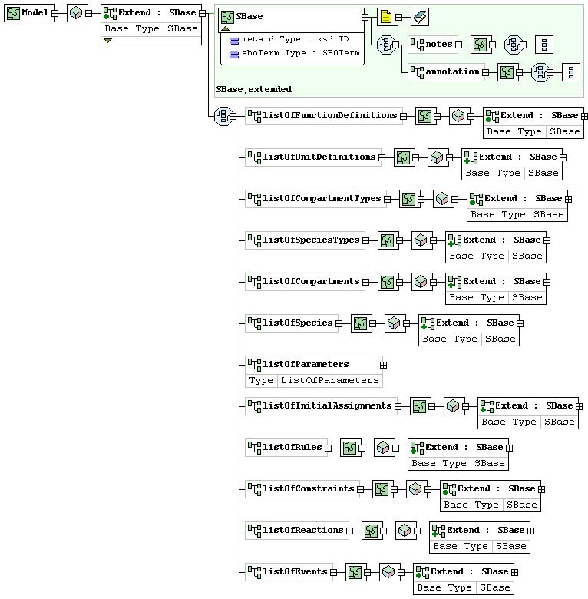
SBML: Structure and Hierarchy (3/3)
Function Definition
Unit Definition
Compartment Type
Species Type
Compartments
Species
Parameters
Initial Assignment
Rules
Costraints
Reactions
Events
Tommaso Mazza

Slide 13
New in Level 2
Identification of objects
  <compartment id="system_0" name="system" outside="system_1"/>
Annotation within the model
  <annotation>
  <Cyto-Sim xmlns:cytosim="http://www.sbml.org/2001/ns/cytosim">
  <plot>
  <species>system_0_NaCl</species>
  <species>system_0_Cl_minus</species>
  </plot>
  <evolve>
    <from>0</from>
    <to>1000</to>
  </evolve>
  </Cyto-Sim>
  </annotation>
Whereas the notes field is a container for content to be shown directly to humans, the annotation field is a container for optional software-generated content not meant to be shown to humans.
Tommaso Mazza

Slide 14
New in Level 2
  Language for kinetic expressions
    <kineticLaw>
    <math xmlns="http://www.w3.org/1998/Math/MathML">
    <apply>
    <times/>
    <cn>1.0</cn>
    <ci>system_0_Na_plus</ci>
    <ci>system_0_Cl_minus</ci>
    </apply>
    </math>
    </kineticLaw>
  Dimensionality of Compartments
    <listOfUnitDefinitions>
    <unitDefinition id="mmls">
    <listOfUnits>
    <unit kind="mole" scale="-3"/>
    <unit kind="litre" exponent="-1"/>
    <unit kind="second" exponent="-1"/>
    </listOfUnits>
    </unitDefinition>
    </listOfUnitDefinitions>
“mmls” for the units mmol l⁻¹ s⁻¹
<compartment id="Extracellular" spatialDimensions="3" size="1"/>
Tommaso Mazza

Slide 15
Concentration and Rules
  Species Concentration
  <species compartment="cytosol" id="ES" initialAmount="0" name="ES" />
  <species id="x1" compartment="cell" initialConcentration="1"/>
  <compartment id="cell" size="1"/>
  Rule Specification
  Algebraic
  Assignment
  Rate
<assignmentRule variable="S2">
<math xmlns="http://www.w3.org/1998/Math/MathML">
<apply>
<times/>
<ci> Keq </ci>
<ci> S1 </ci>
</apply>
</math>
</assignmentRule>
Tommaso Mazza

Slide 16
Initial Assignment and Constraints
Initial Assignment
<listOfInitialAssignments>
<initialAssignment symbol="x">
<math xmlns="http://www.w3.org/1998/Math/MathML">
<apply>
<times/>
<ci> y </ci>
<cn> 2 </cn>
</apply>
</math>
</initialAssignment>
</listOfInitialAssignments>
Constraints
<listOfConstraints>
<constraint>
<math xmlns="http://www.w3.org/1998/Math/MathML">
<apply>
<and/>
<apply>
<lt/>
<cn> 1 </cn>
<ci> S1 </ci>
</apply>
<apply>
<lt/>
<ci> S1 </ci>
<cn> 100 </cn>
</apply>
</apply>
</math>
<message>
<p xmlns="http://www.w3.org/1999/xhtml"> Species S1 is out of range. </p>
</message>
</constraint>
</listOfConstraints>
Species S1 should only have
values between 1 and 100
t ≤ 0
x = y * 2
Tommaso Mazza

Slide 17
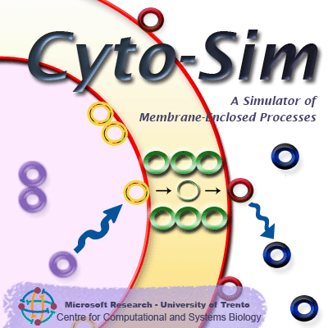
SBML ↔ Cyto-Sim
Cyto-Sim is a stochastic simulator of biochemical processes in hierarchical compartments which may be isolated or may communicate via peripheral and integral membrane proteins.
Online as a:
  Java applet (JRE 1.4)
  Standalone application (JRE 1.6)
You can model:
  interacting species;
  compartmental hierarchies;
  species localizations inside;
  compartments and membranes;
  rules and correlated velocity formulas.
http://www.cosbi.eu/Rpty_Soft_CytoSim.php
Tommaso Mazza

Slide 18
Speaking SBML (species)
/* Objects Declaration */
object speciesA, speciesB, speciesC
/* Compartments Declarations */
compartment compartmentA [ruleA]
compartment compartmentB [compartmentA, ruleB, ruleC,
speciesB, 100 speciesB@7000 : |2 speciesC|]
system compartmentB
<listOfSpecies>
<species id="compartmentA_0_speciesA" name="speciesA"
compartment="compartmentA" initialAmount="0.0"/>
<species id="compartmentB_0_speciesB" name="speciesB"
compartment="compartmentB" initialAmount="1.0"/>
<species id="compartmentC_2_speciesC" name="speciesC"
compartment="compartmentB" initialAmount="2.0"/>
</listOfSpecies>
Tommaso Mazza

Slide 19
Speaking SBML (compartments)
<listOfCompartments>
<compartment id="compartmentA_0" compartmentType="compartmentA"
outside="compartmentA_1"/>
<compartment id="compartmentA_1" compartmentType="compartmentA"
outside="compartmentA_2"/>
<compartment id="compartmentA_2" compartmentType="compartmentA"
outside="compartmentA_3"/>
<compartment id="compartmentA_3" compartmentType="compartmentA"
outside="compartmentB_0"/>
<compartment id="compartmentB_0" compartmentType="compartmentB"
outside="compartmentB_1"/>
<compartment id="compartmentB_1" compartmentType="compartmentB"
outside="compartmentB_2"/>
<compartment id="compartmentB_2" compartmentType="compartmentB"
outside="compartmentB_3"/>
<compartment id="compartmentB_3" compartmentType="compartmentB"
outside="system_0"/>
<compartment id="system_0" compartmentType="system"
outside="system_1"/>
<compartment id="system_1" compartmentType="system"
outside="system_2"/>
<compartment id="system_2" compartmentType="system"
outside="system_3"/>
<compartment id="system_3" compartmentType="system"/>
</listOfCompartments>
<listOfCompartmentTypes>
<compartmentType id="compartmentA"/>
<compartmentType id="compartmentB"/>
<compartmentType id="system"/>
</listOfCompartmentTypes>
Tommaso Mazza

Slide 20
Speaking SBML (rules)
/* Rules Declarations */
rule ruleA {
  speciesA k1-> *
  || + speciesA k2-> speciesA + ||
}
rule ruleB speciesB k3-> speciesC
rule ruleC |speciesC| k4-> || + speciesC
[...]
<reaction id="ruleA.1" name="compartmentA_0_ruleA.1">
<listOfReactants>
<speciesReference species="compartmentA_0_speciesA"
stoichiometry="1.0"/>
</listOfReactants>
<kineticLaw>
<math xmlns="http://www.w3.org/1998/Math/MathML">
<apply>
<times/>
<cn>k1_value</cn>
<ci>compartmentA_0_speciesA</ci>
</apply>
</math>
</kineticLaw>
</reaction>
Mass Action Law
Tommaso Mazza

Slide 21
Speaking SBML (annotations)
evolve 0 - 1000
plot compartmentA[speciesA], compartmentB[speciesB:|speciesC|]
<annotation>
<Cyto-Sim xmlns:cytosim="http://www.sbml.org/2001/ns/cytosim">
<plot>
<species>compartmentA_0_speciesA</species>
<species>compartmentB_0_speciesB</species>
<species>compartmentB_2_speciesC</species>
</plot>
<evolve>
<from>0</from>
<to>1000</to>
</evolve>
</Cyto-Sim>
</annotation>
Tommaso Mazza

Slide 22
Understanding SBML
OK
Parameters:
  global parameters,
  local parameters inside kineticLaw
Species Quantities:
  Cyto-Sim handles quantities and not concentration for species. [size specification required in case of concentration]
Assignments:
  Cyto-Sim handles assignment rules at the moment of parsing to replace values for species quantity, compartment size or parameters value.
NO
Cyto-Sim does not understand
  initial assignments;
  rules;
  lamda-functions.
  Units & Constraints
Tommaso Mazza

Slide 23
Binding to the SBML Schemas (1/2)
Employed Tools
Java Architecture XML Binding (JAXB) (https://jaxb.dev.java.net/)
  Unmarshalling/Marshalling valid SBML documents;
  Validating SBML documents.
XML DOM parser
  Check Levels and Versions
  Parse MathML expressions
Tommaso Mazza

Slide 24
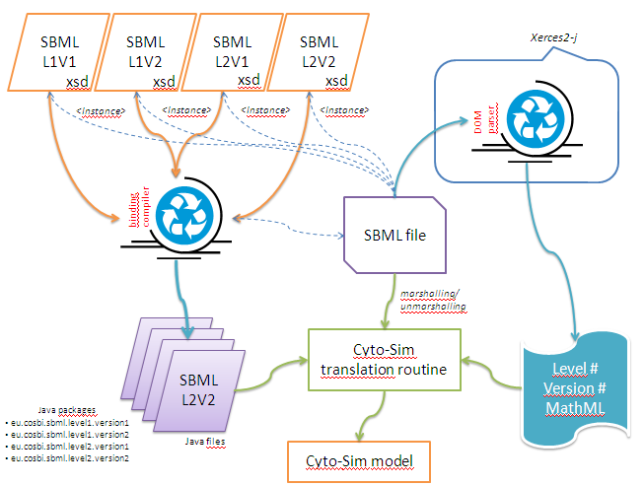
Binding to the SBML Schemas (2/2)
Tommaso Mazza

Slide 25
Experimental Tests
The capability of Cyto-Sim to understand all currently existing SBML levels and versions has been tested on almost all official existing SBML files available on the web.
567 Models
I obtained a successful
test, when Cyto-Sim had been able to correctly parse the inferred model.
Repository | Models | Level & Version
Gepasi | 9 | L1 v1
BioModels | 70+ 43 | L2V1
PANTHER | 130 | L1V2
CellML | 238 | L2V1
KEGG | 77 | L2V1 & L1V2
98% correctly parsed
Tommaso Mazza

Slide 26
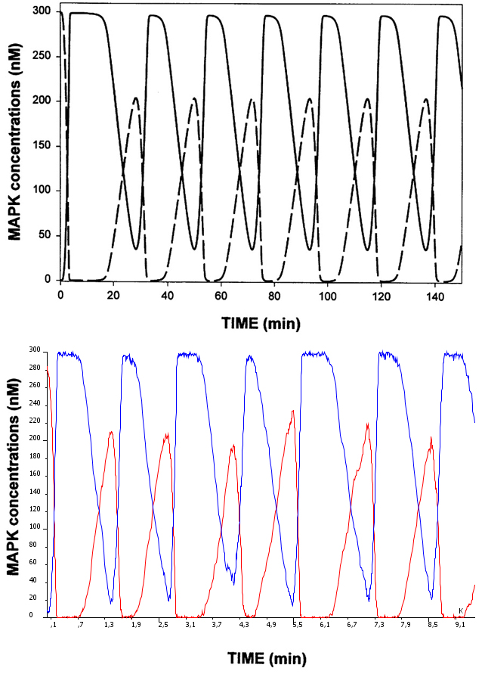
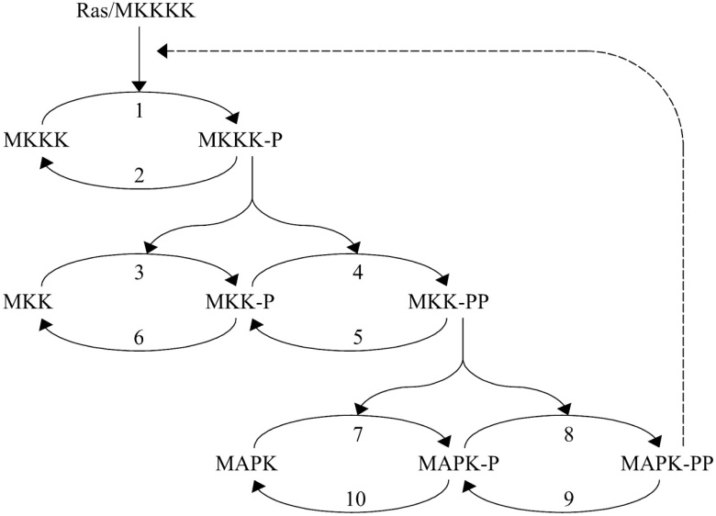
BioModels:: BIOMD0000000010
object MKKK, MKKK_P, MKK, MKK_P, MKK_PP, MAPK, MAPK_P, MAPK_PP
rule J0 MKKK ((1.0*2.5*MKKK)/((1+((MAPK_PP/9.0)^1.0))*(10.0+MKKK)))-> MKKK_P
rule J1 MKKK_P ((1.0*0.25*MKKK_P)/(8.0+MKKK_P))-> MKKK
rule J2 MKK ((1.0*0.025*MKKK_P*MKK)/(15.0+MKK))-> MKK_P
rule J3 MKK_P ((1.0*0.025*MKKK_P*MKK_P)/(15.0+MKK_P))-> MKK_PP
rule J4 MKK_PP ((1.0*0.75*MKK_PP)/(15.0+MKK_PP))-> MKK_P
rule J5 MKK_P ((1.0*0.75*MKK_P)/(15.0+MKK_P))-> MKK
rule J6 MAPK ((1.0*0.025*MKK_PP*MAPK)/(15.0+MAPK))-> MAPK_P
rule J7 MAPK_P ((1.0*0.025*MKK_PP*MAPK_P)/(15.0+MAPK_P))-> MAPK_PP
rule J8 MAPK_PP ((1.0*0.5*MAPK_PP)/(15.0+MAPK_PP))-> MAPK_P
rule J9 MAPK_P ((1.0*0.5*MAPK_P)/(15.0+MAPK_P))-> MAPK
compartment uVol[J0, J1, J2, J3, J4, J5, J6, J7, J8, J9, 280.0 MAPK,
10.0 MKK_P, 10.0 MKK_PP, 10.0 MKKK_P, 10.0 MAPK_PP, 280.0 MKK,
10.0 MAPK_P, 90.0 MKKK]
system uVol
evolve 0-33000
plot uVol[MAPK,MAPK_PP]
1 compartment,
8 species,
10 reactions.
Tommaso Mazza

Slide 27
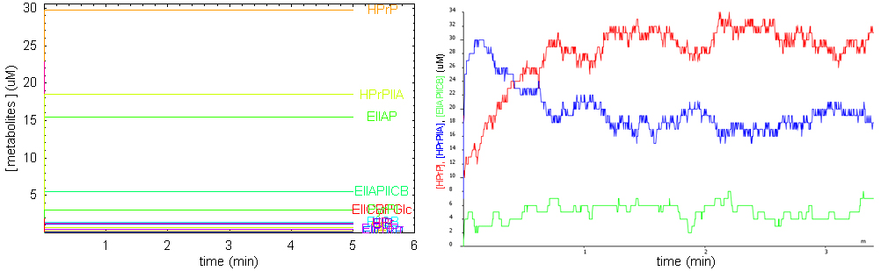
JWS Online:: Glucose Transport
object EI, PyrPI, EIP, HPr, EIPHPr, HPrP, EIIA, HPrPIIA, EIIAP, EIICB,
EIIAPIICB, EIICBP, EIICBPGlc, PEP, Pyr, GlcP, Glc
rule v1 PEP + EI ((1960.0*PEP*EI)-(480000.0*PyrPI))-> PyrPI
rule v2 PyrPI ((108000.0*PyrPI)-(294.0*Pyr*EIP))-> EIP + Pyr
rule v3 HPr + EIP ((14000.0*EIP*HPr)-(14000.0*EIPHPr))-> EIPHPr
rule v4 EIPHPr ((84000.0*EIPHPr)-(3360.0*EI*HPrP))-> HPrP + EI
rule v5 HPrP + EIIA ((21960.0*HPrP*EIIA)-(21960.0*HPrPIIA))-> HPrPIIA
rule v6 HPrPIIA ((4392.0*HPrPIIA)-(3384.0*HPr*EIIAP))-> EIIAP + HPr
rule v7 EIICB + EIIAP ((880.0*EIIAP*EIICB)-(880.0*EIIAPIICB))-> EIIAPIICB
rule v8 EIIAPIICB ((2640.0*EIIAPIICB)-(960.0*EIIA*EIICBP))-> EIICBP + EIIA
rule v9 EIICBP + Glc ((260.0*EIICBP*Glc)-(389.0*EIICBPGlc))-> EIICBPGlc
rule v10 EIICBPGlc ((4800.0*EIICBPGlc)-(0.0054*EIICB*GlcP))-> EIICB + GlcP
compartment compartment_cyto_sim[v1, v2, v3, v4, v5, v6, v7, v8, v9, v10,
0.0 EIICBPGlc, 5.0 EIICBP, 25.0 HPrP, 2.0 EIP, 20.0 EIIA, 5.0 EIICB,
25.0 HPr, 2800.0 PEP, 0.0 PyrPI, 0.0 EIPHPr, 50.0 GlcP, 900.0 Pyr,
0.0 HPrPIIA, 20.0 EIIAP, 500.0 Glc, 0.0 EIIAPIICB, 3.0 EI]
system compartment_cyto_sim
evolve 0-10000
plot compartment_cyto_sim[HPrP,EIIAPIICB,HPrPIIA]
1 compartment,
17 species,
10 reactions.
Low species populations
Fluctuations
Tommaso Mazza

Slide 28
Reactome: Homo Sapiens
The actual release of the human reactome I used is an SBML file containing:
  28 compartments,
  3054 species (in all their forms),
  1979 interactions represented by means of reactions.
Cyto-Sim is able to parse and even to simulate it, although it misses of quantitative parameters (reaction rates and initial species quantities).
Tommaso Mazza

Slide 29
Future Plan
Bug Fix (send email to mazza@cosbi.eu)
Add Missing (if compatible) Features:
  Units of Measurements (?),
  Events,
  Rules and Functions.
Extend to SBML L2 V3
GUI for designing P Systems,
IDEA
A common interface to understand/speak SBML from/to the existing simulation/modelling P Systems tools?
Tommaso Mazza

Slide 30
Acknowledgment
Corrado Priami
Matteo Cavaliere
Sean Sedwards
Tommaso Mazza

Slide 31

Thank You
Tommaso Mazza

